Slide 1

An Experimental Framework to Evaluate Distributed Decision-Making Algorithms in Dynamic and Contested Environments
Shivam Savani (a1796824)
Supervised by Prof. Claudia Szabo
Notes:
- I might change the title to something entirely relatable or else I will keep it as it is

Slide 2




Introduction
Distributed Decision-Making Algorithms
There are just too many of them. It gets difficult to evaluate their efficiency and robustness
We need some framework to compare them before any real-world applications
Scope of my project is to implement this testing framework
Notes:
Define and explain what distributed decision making algorithms are and how they closely simulate real world environment
Define the problem of these algorithms being too many and how it gets difficult to analyze them against each other
We need a better and efficient way to evaluate them as manual testing would be tedious for just comparing 10 decisions for example
My main aim of the project is to implement a testing framework which can evaluate and compare any decision-making algorithm with any use-case

Slide 3
Motivation + Significance
Present Netlogos lane changing model is limited to only one decision-making model
Testing framework will automate the entire process of analyzing various decision-making algorithms on varying dynamic and contested environments
It can answer if a model is better at maximizing the distance travelled with lane changing compared to others?
Notes:
NOT SURE IF THIS IS ENOUGH OR HAVE TO MORE BITS IN IT
Define what Netlogos is first before approaching the point
Explain how the traffic model in Netlogos just works for one decision by default
Testing framework can decrease time on comparing these algorithms by a bit and Netlogos can be used to contest environment
Who would not prefer an answer to that question? (STILL THE WORDING IS A BIT OFF)

Slide 4



Approaches
Decision Making Algorithms (Rule-Based)
Experimental Framework (Netlogos)
Testing Framework (Python Package)
Notes:
Briefly my project into 3 different parts: START WITH SOMETHING BETTER THAN THIS AND EXPLAIN HOW IT IS A TRAFFIC LANE MODEL
Decision making algorithms were implemented for a rule-based decision of choosing a new lane by a car (FIND BETTER WORDING)
These decision-making algorithms were used in a modified experimental framework provided by Netlogos (FIND A GOOD INTRODUCTION)
Data sets generated from Netlogos were then filter, modified and evaluated by a testing framework provided as a python package

Slide 5
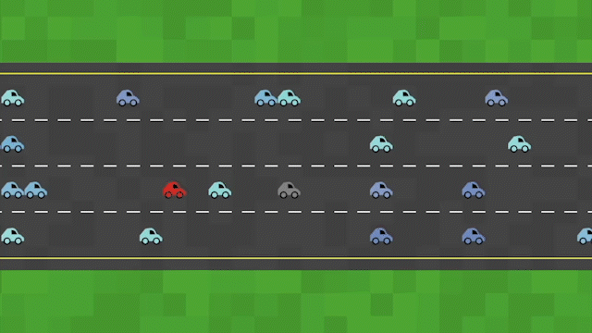
Lane Changing Decision
Notes:
Define the decision first. Whenever a car’s total patience decreases to 0, it calls a decision-making algorithm to pick a new lane.
The first red one selects the lane on top of it, whereas, as can be seen one other red car took the lane at the bottom.

Slide 6






Rule-based Decision-Making Algorithms
Decision 1: picks the nearest lane
Decision 2: picks the lane with the least number of car
Decision 3: picks the lane in which the car itself has travelled the most in
Decision 4: picks the lane with the least number of cars in front of its view
Decision 5: picks the lane using an Analytic Hierarchy Process (AHP) model
Decision 6: picks the lane using an advanced AHP model
Decision
Notes:
Gif added
D1 picks the nearest lane to minimize the lane change distance and time
D2 picks the lane with the least number of cars in a given window on it to minimize the load
D3 picks the lane in which the car itself has travelled the most in
D4 picks the lane like D2 with the least number of cars in front of it in a given window
D5 picks the lane using an Analytic Hierarchy Process (AHP) model that uses the above 4 decisions as criteria to compare the lane alternatives to the criteria
D6 picks the lane using an advanced AHP model that also uses the above AHP model as one of its weights
Decision is to pick a new lane whenever prompted to

Slide 7
Experimental Framework (Netlogos)
Distributed Systems Environment
Wrapped World
Traffic feature implemented
Code modified to use different algorithms to choose a new lane
Automated testing tool BehaviourSpace
Gif the Break-down traffic feature
Gif of the code that uses different algorithms or show the model just literally running
Gif of the testing tool to create the dataset
Notes:
The environment is distributed systems which means that they might be taking the same decision as the other one did?
The world for Netlogos is like an infinite horizontal pipe. It updates all the coordinates as required
Traffic feature implemented in Netlogos, HAVE SENT YOU THE MAIL FOR THIS PRESENTATION JUST IN CASE
Code modified to be able to choose from a whole set of variable and also the use case. (REWORD THIS. IT STILL DOES NOT MAKE SENSE)
Talk a bit of BehaviourSpace

Slide 8
Testing Framework (Python Package)
Framework uses Jupyter Notebook, Python and Matplotlib for analysis
Implemented as a python package for easy use
Capable of analyzing any number of datasets and decisions
Will have a gif to back up what you just mentioned
Will give a bit of an explanation as well
Notes:
- First connect to the previous slide by mentioning that you are going to use the data generated there here to evaluate an algorithm here

Slide 9




Testing Framework Process
Filters and modifies the data which is suitable for plotting
Normalizes the runs for each decision to one run to generalize the decision
Generates line and bar plots to evaluate which decisions were better
Generates moving average plots to analyze trends in distance travelled b/w two lane changes in any subset of lane changes

Slide 10
Demo for the testing framework
Will prepare a video where I first present the raw data
Then the dictionary and importing class
And finally getting the plot for the 50 cars model
Which then gets connected to my next slide of results
Notes:
Let me load the data-set generated from Netlogos into the testing framework
Once you get the plot, jump on the results slide and start presenting that
ALSO MENTION HOW YOU DID 100s OF TESTS TO OPTIMISE ALL THE MODELS

Slide 11
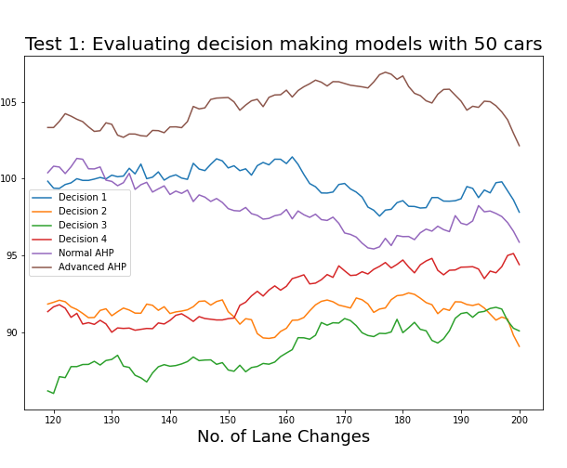
Result
Analysis of Moving Average of distance travelled between two lane changes
Advanced AHP did much better than all the alternatives
Decision 1 performed similar to normal AHP model
Decision 4 peaked at the end, otherwise similar to decision 2
Decision 3 turned out to be the least efficient
Notes:
Analysis of Moving Average of distance travelled between two lane changes for a window size of 120
Also mention that the test had 10 runs each for a decision and a run consisted of data for 200 lane changes

Slide 12



Future Work
More Obstacles and travel directions can be added to the Netlogos environment to make it more dynamic
Various decision-making algorithms such Dynamic AHP, Multi-Criteria Decision Making (MCDM) or Machine Learning model can be implemented to evaluate their efficiency
Testing framework could be expanded to have features like dynamic visualizations, statistical analysis plots or comparing 2 different use-cases

